Slide 1
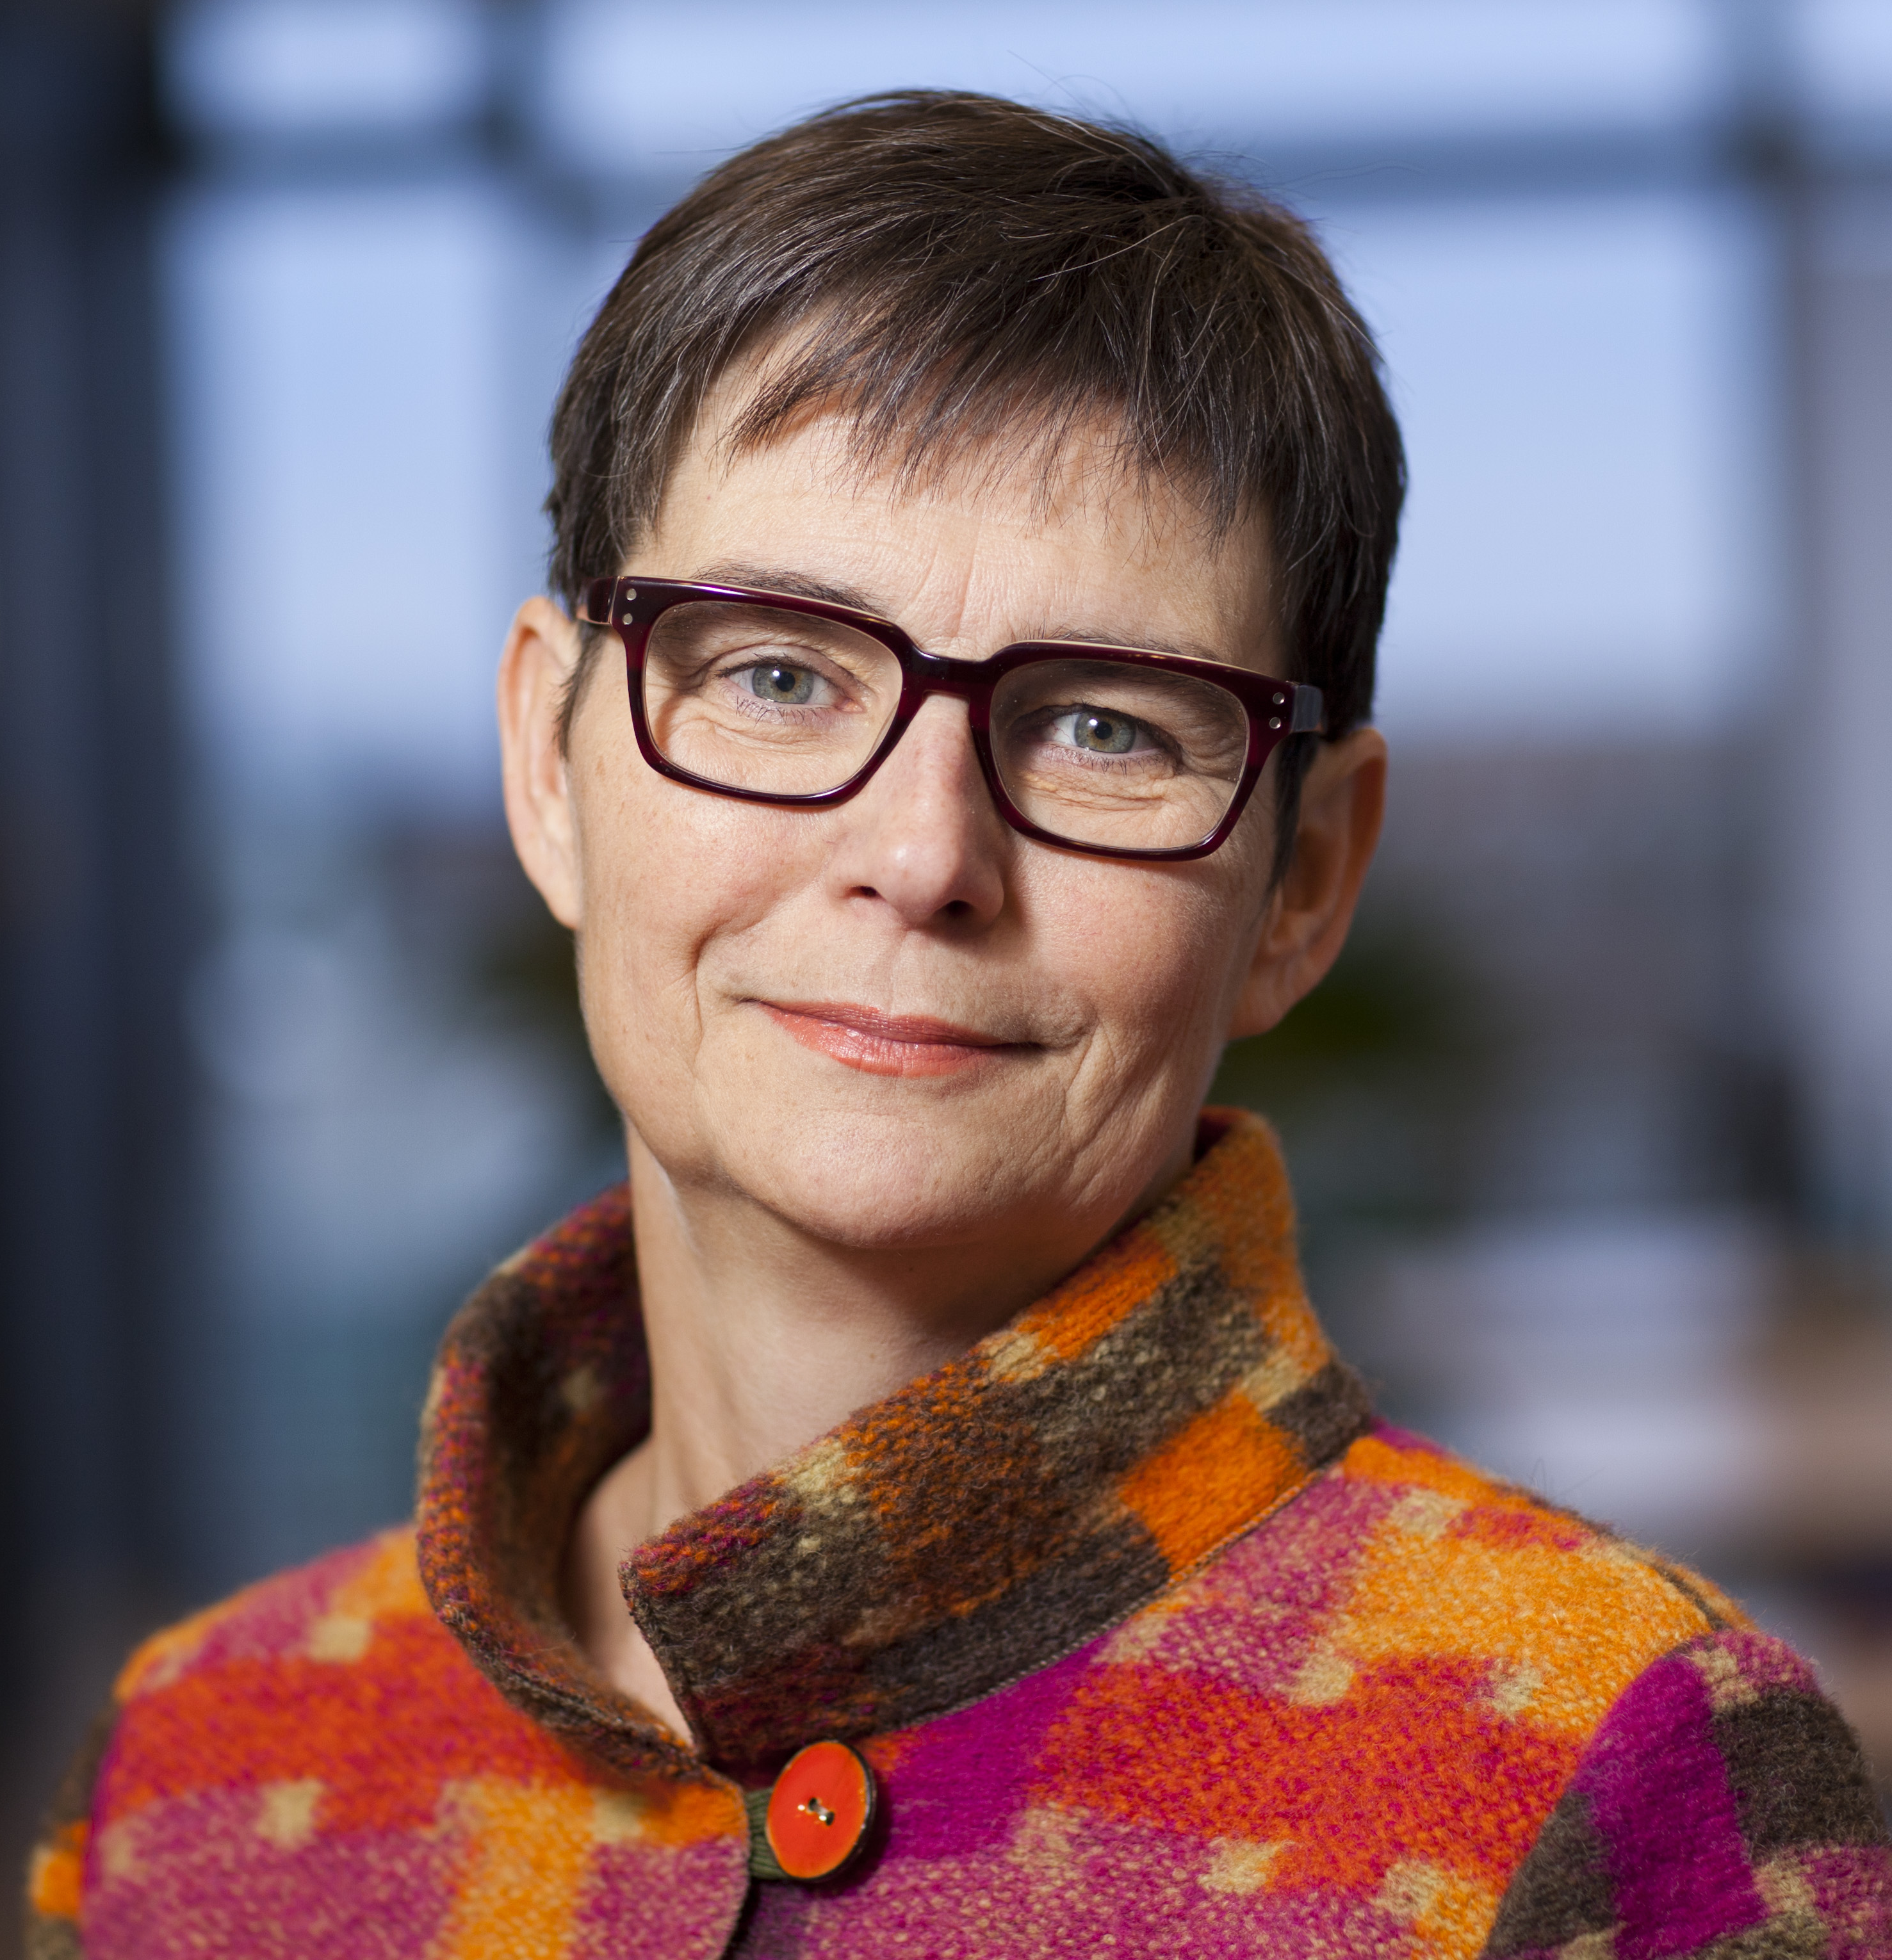
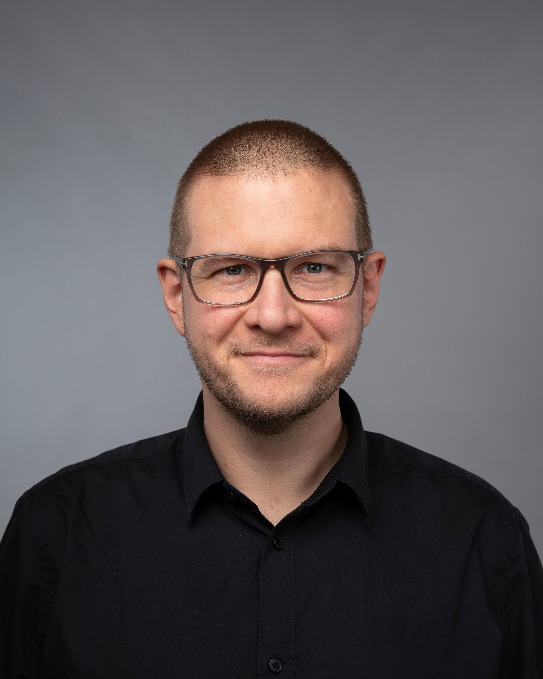

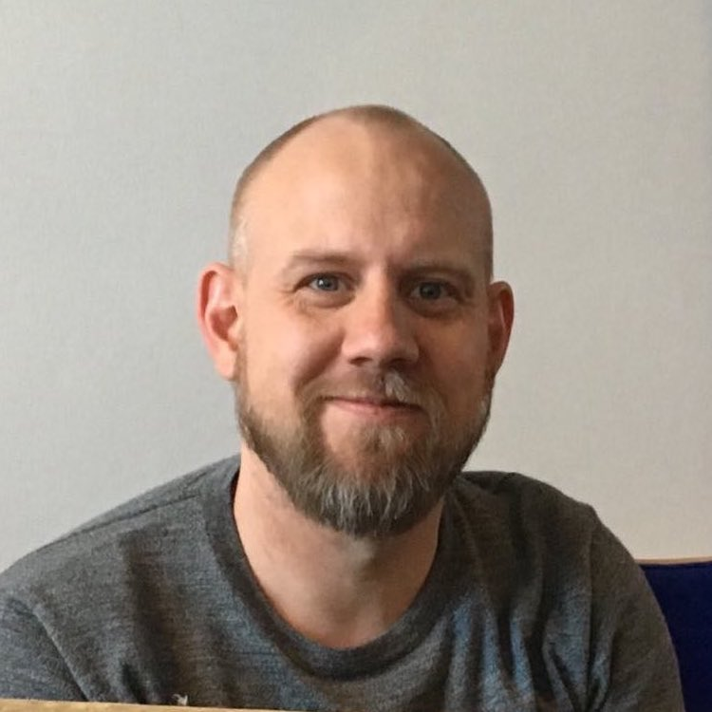
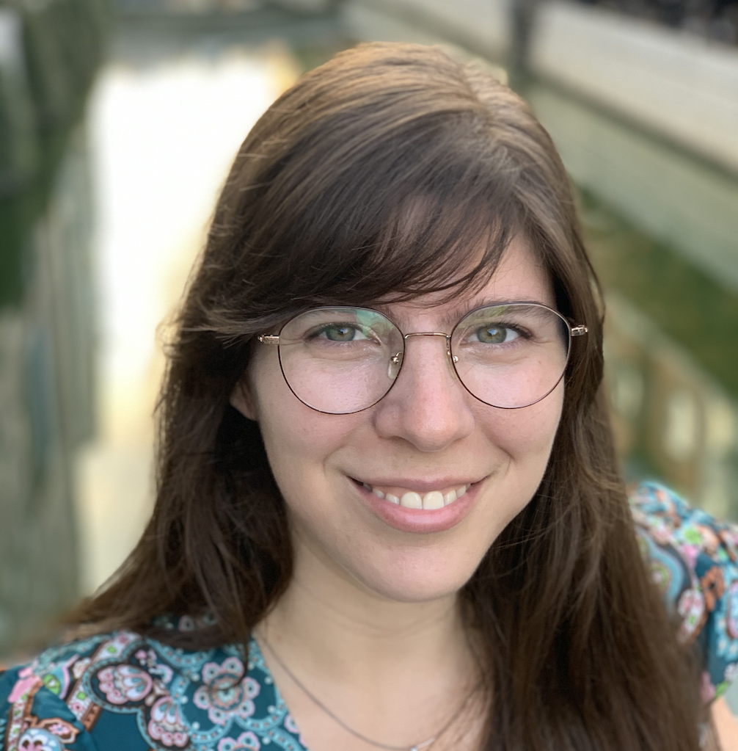

COLLABORATION & COMPUTER-HUMAN INTERACTION (CoCHI)
Susanne Bødker
Clemens Klokmose
Eve Hoggan
Henrik Korsgaard
Carla Griggio
Michael Wessely

Slide 2
What do we do?
Empirical Stuff
How do people appropriate and use interactive technology in various contexts?
Theoretical Stuff
How can we analyze and theorize human-computer interaction?
Technical/Constructive Stuff
How can we construct technical alternatives in human-computer interaction?
Empirical
Constructive
Theoretical

Slide 3
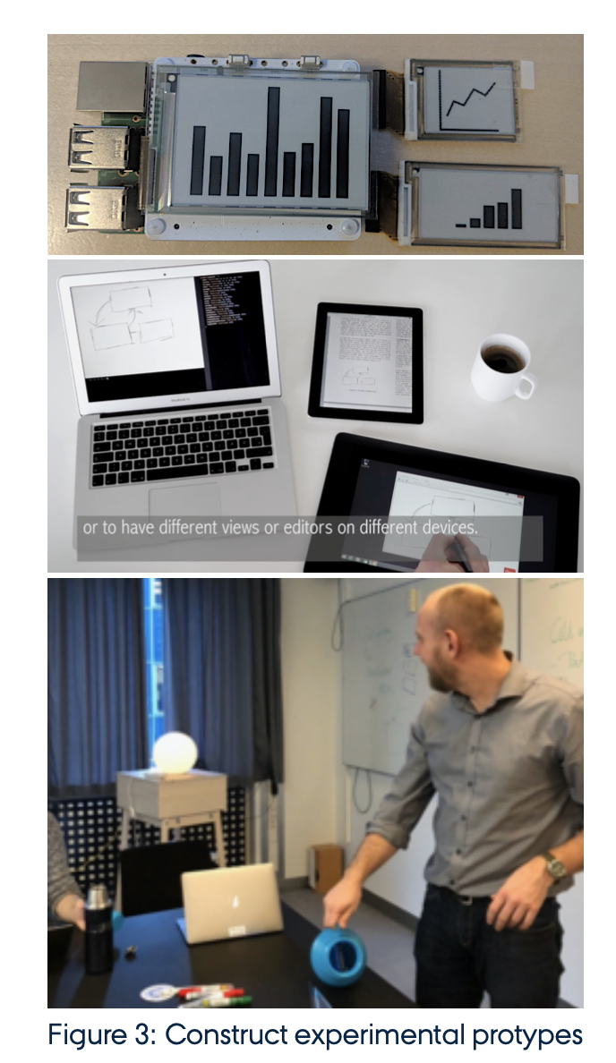
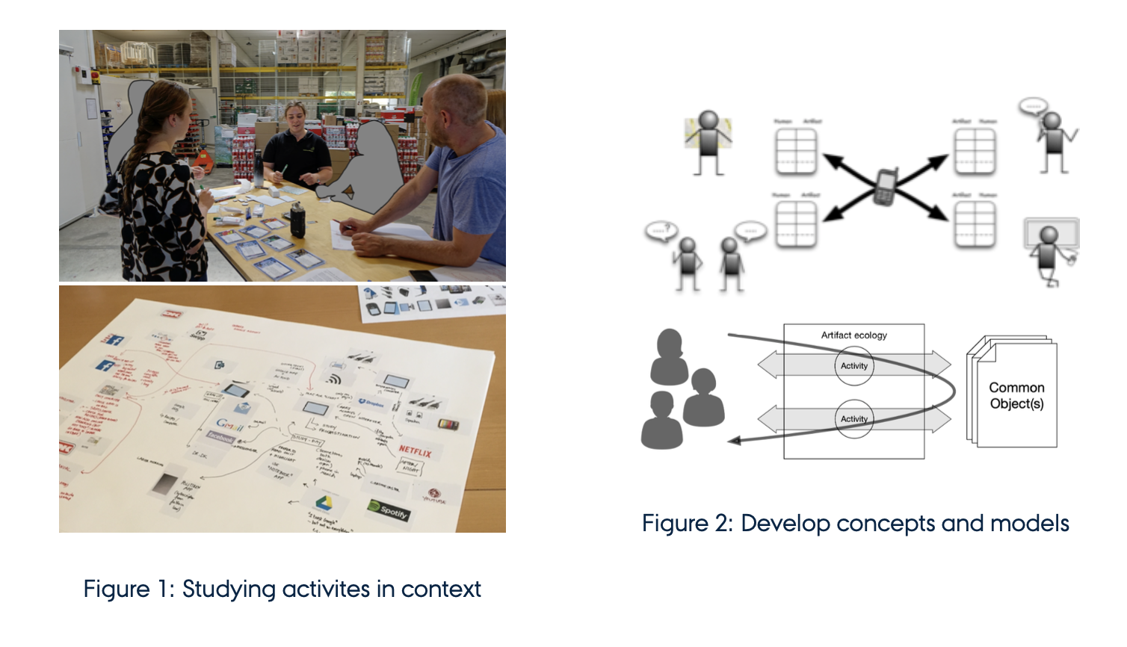
What do we do?
Insert Quote text, for next level ENTER and TAB
Insert Name

Slide 4
Projects
RepliCHI
Select 1 or 2 classical experiments from HCI. Examine the literature and develop experiments aiming at replicating the classical work.
Human-Data Interaction with Public Data
Study how existing users of open data use the data, or collaborate with existing and new user groups in designing tools and applications based on data (journalists, organisations, individuals etc.), or appropriate existing techniques for data exploration, wrangling, analyses, collaboration etc. to a particular data platform

Slide 5
Projects
Family stories, sharing of family trees and data quality, physically and/or through online platforms like MyHeritage
Examine how users of MyHeritage or amateur genealogist engage with and share records, data, visualizations and more in their search and hobby, or
Examine alternative redesigns, tools, representations and applications on top of GEDCOM or other resources within the practice.
Shared traces in collaborative virtual activities.
Identify a collaborative activity and explore the possibilities of augmenting this through traces

Slide 6
Projects
Applications for re-programmable high-resolution textures on physical objects using photochromic dyes
find new application areas for reprogrammable materials.
Fabricating large-scale user interfaces in architecture
extend the current state-of-the-art to computer-controlled spraying drones
Haptic textures in 3D printing
develop a novel 3D printing technique that creates objects that are printed with standard filament such as PLA but create the haptic experience of wood, stone, or glass when users touch them.

Slide 7
PROJECTS
Magnetic Haptic Feedback
explore the possibilities of creating distinguishable haptic feedback using magnets
Collaborative customizations for messaging apps
think of creative designs and implementations that explore the concept of “co-customizations” (collaborative customizations) applied to messaging apps

Slide 8
Projects
Declarative programming of interaction in computational notebooks
experiment with how Varv can be used in the context of computational notebooks, build a prototype, and design a small user study.
Interactive and collaborative JavaScript exercises in CoTinker
explore how CoTinker can be used to design learning activities around JavaScript programming
Violations of personal digital sovereignty
Pick a profession (electronic musicians, patent clerks, architects, teachers, medical doctors...) and document when and how their personal digital sovereignty is violated

